Slide 1


Meteo Student Linux Workshop
Penn State Department of Meteorology and Atmospheric Science
PSU Weather Data Science Club
3 October 2022

Slide 2
Acknowledgments
This presentation would not have been possible without Shawn Murdzek’s work putting this together for the graduate students last year (2021).
This work is licensed under the Creative Commons Attribution 4.0 International License. To view a copy of this license, visit http://creativecommons.org/licenses/by/4.0/.

Slide 3
Workshop Overview
Goal: Teach the basics of working on the PSU METEO Linux network using the terminal
Prerequisite Knowledge: You’ve used a computer before and have some experience with Windows or Mac OS
Structure: Two sessions with a break in between
~ 45 Min | What is Linux? | Terminology, basic principles, and basic commands
~ 10 Min | Break
~ 45 Min | Hands-on Exercises | More advanced commands, running code

Slide 4

Session 1: What is Linux?
https://www.britannica.com/technology/computer

Slide 5
Operating System (OS): Handles hardware-software communication. The central part of the OS is called the kernel
Windows
Mac OS
Linux
UNIX-like
Debian
Red Hat
Ubuntu
CentOS
Linux Distributions (“flavors”)
Linux is a popular choice for supercomputers (e.g., PSU Roar, NCAR Cheyenne)
One of the benefits of Linux is that it is open source, which means the kernel is free and people can tinker with it
Notes:
PSU METEO Linux network uses CentOS
Source: https://www.linux.com/what-is-linux/

Slide 6
Some Computer Jargon
Server: Any device (e.g., computer) that processes requests made by clients
Ex) Web servers deliver website information to users when surfing the internet
Ex) Cloud servers are remote computers that can be accessed over the internet
Cluster: A collection of computers used to perform computationally-intensive tasks
Ex) NCAR Cheyenne supercomputer
Node: A single device in a larger network (e.g., server, printer, desktop)
Central Processing Unit (CPU): Can refer to the computer chip (e.g., Intel i7) or the number of cores (each core can handle one process)
“Core,” “CPU,” and “processor” tend to be used interchangeably
See slides at the end of this presentation for a deeper dive on this topic
Parallelization: Dividing a task between multiple cores for increased efficiency
“Using a comb instead of a toothpick to comb your hair”
Notes:
It’s also worth noting that I use the terms “machine” and “computer” interchangeably
The command “lscpu” can be used in Linux to display the number of sockets, cores, threads, and CPUs
Sources: https://www.computerhope.com/jargon/s/server.htm, https://researchcomputing.princeton.edu/faq/what-is-a-cluster, https://www.icds.psu.edu/computing-services/roar-user-guide/

Slide 7
PSU METEO Linux Network
lethe
charney
rita
graupel
twist
home
And so on...
Different servers (most research groups have their own servers)
meteo
In addition to the space allotted on home, students typically have large amounts of space on their research group’s server as well
sfm5282
pmm116
cnl18
And so on...
Each user has their own space in home (~40 GB limit)
PSU METEO servers live on the sixth floor in a sealed room

Slide 8
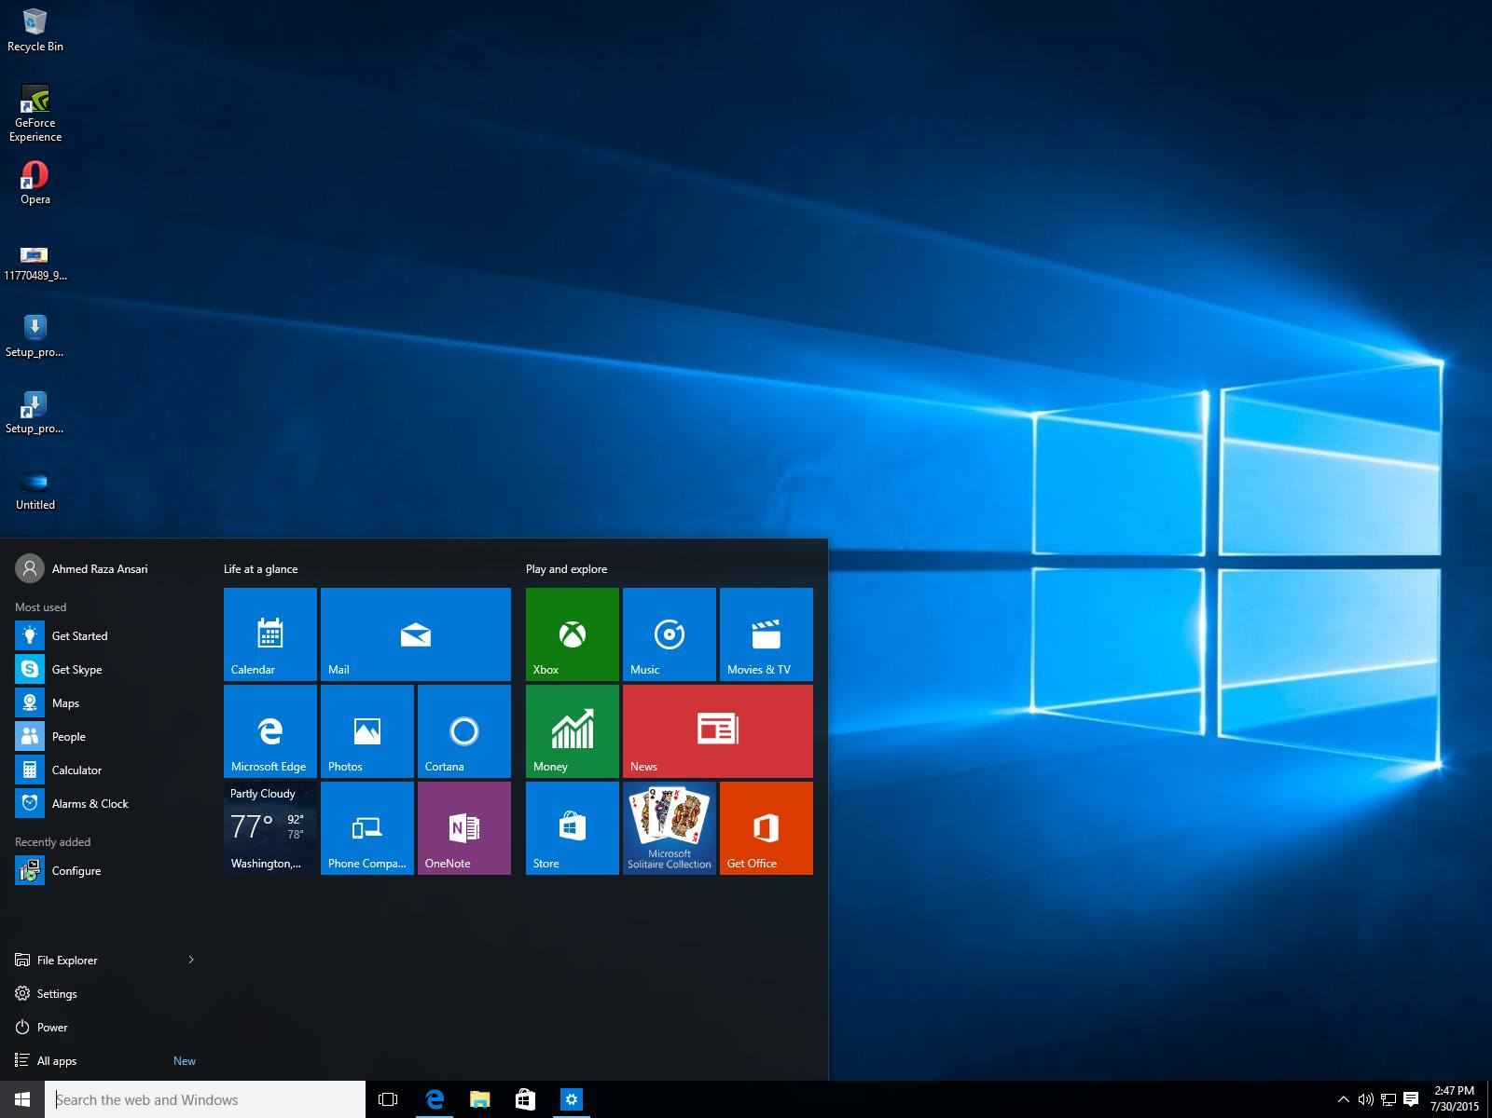
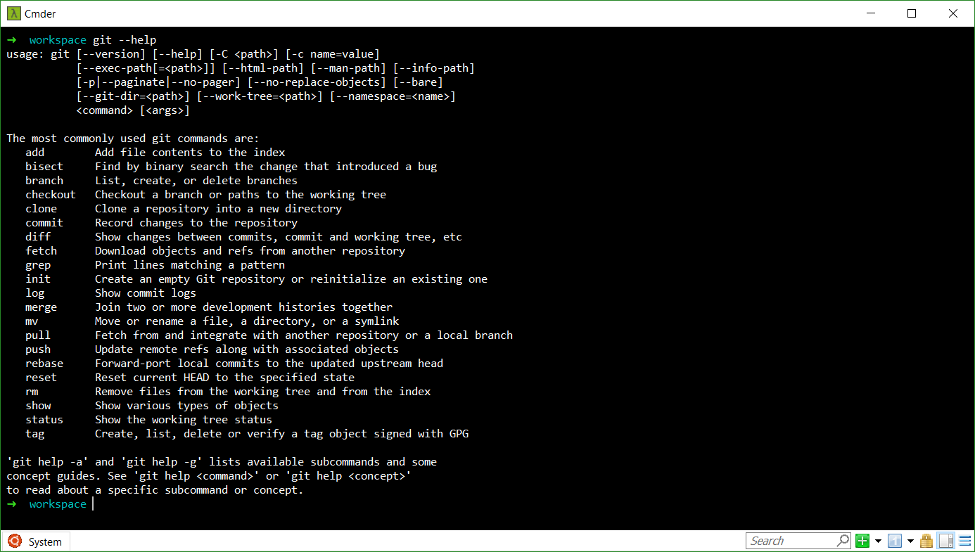
GUI vs. CLI
https://hackernoon.com/hn-images/1*2Pw7--evUBCs5IJVTuqI2A.png
http://i.imgur.com/JqoHi81.jpg
Graphical User Interface: User interacts with computer using graphics. Often more user friendly, but generally slower and less precise
Command Line Interface: User interacts with computer using typed commands. Often harder to use, but generally faster and more efficient (UNIX CLI is called “the shell”)
Notes:
PSU METEO Linux Cluster only has a CLI
Source: https://www.educba.com/gui-vs-cli/

Slide 9

Connecting to the PSU METEO Linux Network
Windows: Prior to Windows 10, PCs could not connect to Linux servers on their own. Instead, they used a third-party terminal emulator (e.g., MobaXterm, PuTTY)
Machines running Windows 10 can use ssh from the Windows command line
Mac: Can connect to Linux servers using the Terminal app
Procedure:
Install MobaXterm (see next slide)
Click “Start local terminal”
Type ssh abc1234@ulteosrv2.met.psu.edu
Authenticate
Note: All commands will be given in Courier New and placeholders will be underlined
Notes:
Note that the CLI in Mac is basically identical to Linux, but the CLI in Windows is very different
Note that Courier New will be used for terminal commands and arrows (instead of bullets) will be used for procedures
ssh = secure shell protocol

Slide 10
Downloading MobaXterm on the Walker Workstations
Each user must download MobaXterm into their profile space
The system administrator (Chad) can’t do this for us
I recommend the Desktop folder, but V:\ or X:\ should work as well
Steps:
Visit https://mobaxterm.mobatek.net/download.html
Download the Home Edition (Portable Version)
Copy zip file from Downloads into Desktop (or other desired location)
Unzip zip file
Double-click the application to run
You’ll get a couple of warnings, just run anyways
I also recommend creating a shortcut and adding that to your home screen
Notes:
Chad used to be able to download and install MobaXterm for all of us, but now he can’t due to the license agreement. PuTTY is installed by default on all Walker workstations, but enabling X11 forwarding in PuTTY is a bit of a pain. Thus, I’ll have all of you download MobaXterm so that way you can use it whenever you log onto a Walker workstation.

Slide 11
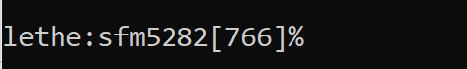
The Shell: The UNIX CLI
Linux Server Name
Username
Line Number
Type Commands Here
Default shell for the METEO network is tcsh (enhanced UNIX Berkeley C shell)
Other common shells: bash, ksh, zsh
Basic functionality is nearly identical between the different shells
Can switch to bash by simply running the command bash (to go back to tcsh, run exit)

Slide 12
Linux Commands: Syntax
command [options] [arguments]
Begin with “-” or “--”
Usually a file or directory name
These are optional
Try the following commands…
ls | List storage
ls --help | Display the help page for ls. Most commands have this option
ls -l | Same as ls but with the “long” option (shows more information)
man ls | Display the documentation (manual) for ls
Notes:
Will cover ls -l output later
Note that dark blue highlighted items are directories, other items are files

Slide 13
Moving Around a Linux System
File Tree: Layout of folders (shown on right)
pwd prints your location in the file tree
Changing directories (command: cd)
cd / (move to root directory)
cd /home/meteo/abc1234/Documents
Absolute Path: Full path name (starts with /)
Relative Path: Path is relative to current directory
/
lethe
home
rita
etc.
meteo
sfm5282
… and other users
Documents
Downloads
etc.
. | Current directory
.. | Up one level
~ | Home directory

Slide 14
Creating and Removing Directories
mkdir makes a directory, rmdir removes an empty directory
Try the following:
cd ~
mkdir test
ls (this should show a new directory)
rmdir test
ls
Notes:
At this point, I might just show my terminal window and continue without the slide show

Slide 15
Create a Sample Directory and Sample Files
cd ~
mkdir test_dir
cd test_dir
touch my_file
nano my_file (add some text, WriteOut, then Exit)
nano my_file2 (add some text, WriteOut, then Exit)
file my_file2 (show file type, should be an ASCII text file)
Note that “^X” means to hold down the control key (perhaps command on Mac), press “X”, then release both keys; this is also written “Ctrl-X”

Slide 16
Moving and Removing Files
cd ~/test_dir
mv my_file .. (move my_file to parent directory with same name)
cp my_file2 .. (copy my_file2 to parent directory with same name)
ls .. (list contents of parent directory)
ls
cd ..
rm my_file2 (remove my_file2)
rm my_file
Removing a file is forever! There is no undo or recycling bin!
Useful options for rm:
rm -r: Remove all files and folders within a directory. Be careful with this command!
rm -i: Receive a confirmation message each time you try to delete a file

Slide 17
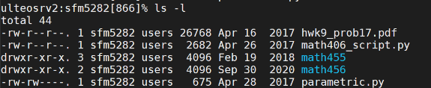
ls -l Output
File type (d = directory, - = regular file)
File permissions (next slide)
Number of hard links to the file
File owner
File group
File size (bytes, use -h option to get “human readable” units)
Date last modified
File name

Slide 18
File Permissions
Contains 3 groups of 3 letters
r = read, w = write, x = execute/view contents, - = permission not granted
rwxrw-r--
Owner
Group
Everyone Else
Changing permissions: chmod permissions file
permissions is a series of who=y statements separated by commas, where who is u, g, o, or a (see table), “=” can also be “+” or “-”, and y are the permissions
Example:
touch test_file
chmod u=rwx,g=r test_file
ls -l
u | User
g | Group
o | Others
a | All
Notes:
Note that - or + can be used instead of = to remove or add permissions, respectively

Slide 19
The Module System
Used to load packages not installed in the standard Linux distribution
Example: Using ipython
The default python version is old and does not contain ipython (try running ipython)
module list (shows loaded modules)
module avail (shows all modules that can be loaded)
Modules with a (D) are the default modules
module spider python (shows available python packages that can be loaded)
module load python (loads python/3.8.3_anaconda, can now run ipython!)
module swap python/3.7.6_anaconda (switches python package)
module purge (unloads all packages)

Slide 20
Aliases
Linux command shortcuts
The METEO network comes with many built-in aliases
alias prints all defined aliases
New aliases can be created using the command alias name “command”
Aliases only last for the given shell session (e.g., until you log out)
Example:
cd ~
mkdir dir1
mkdir dir1/dir2
alias dd “cd ~/dir1/dir2/”
dd (this should move you into dir2)

Slide 21
Login Files (.cshrc.cat)
Hidden files begin with a . and can be displayed using ls -a
One useful hidden file is your login file (~/.cshrc.cat), which runs when you start a new tcsh in linux
Within this file, you can load modules, create aliases, etc.
Try the following:
Add the line “module load python” to your .cshrc.cat file
Open a new tab in MobaXterm and log into ulteosrv2
The python module should be loaded after you login
You might want to make rm an alias for rm -i in your .cshrc.cat file
Notes:
If you use bash, you’ll want to edit the file “.bashrc”

Slide 22
Checking Storage Limits
Users have a limited amount of space in their home space
Use the command quota to display how much space is used and how much is left
Use the -s option to print the quota in human-readable units
Other useful commands:
du = Disk usage, estimates the amount of space each file/folder takes up
du -h = Human-readable units
du -d x = Max depth (= x)
The output here is very long! You can write the output to a text file using du > file
df = Disk free, displays the amount of available space on the file system
df -h = Human-readable units

Slide 23
Exploring Other Text Editors: vim
Vim is less intuitive than nano, but it provides a lot more functionality than nano
Vim has two main modes:
Command: Similar to a CLI. Includes commands to move around a document, copy text, delete text, save your work, etc.
Vim defaults to command mode when you open a document
Insert (edit): Allows the user to type text
Useful commands:
i = Switch to insert mode
Esc key = Switch back to command mode
:w = Save work (in command mode)
:q = Quit vim (in command mode)
:q! = Quit vim without saving (in command mode)
Notes:
Fairly quick tutorial on vim: https://hbctraining.github.io/Intro-to-Shell/lessons/03_vim.html

Slide 24
Editing and Running Code
Up to this point, we have only discussed command line tools
To make life easier, there are various GUIs available
We can run, edit, and debug code on the Meteo servers
Python
Spyder spyder
JupyterLab* (many types of files) jupyter lab
Matlab: matlab
Text editors: gvim, emacs, geany, gedit
*if you need help setting up JupyterLab, please contact Karl (kps5442@psu.edu)

Slide 25
Screen Sessions
Allows you to keep your terminal session active, even after logging out
Useful if you have code that takes a long time to execute
Syntax
Start a screen session: screen
Detach (leave) a screen session: ctrl+A; D
Resume a screen session: screen -r
Exit (close) screen session: ctrl+D
List running screen sessions: screen -ls

Slide 26
Session 1: Key Take-Home Points
Linux is an operating system typically used on high-performance computers
The PSU METEO Network, as well as NCAR Cheyenne and PSU Roar, use Linux
The command line interface (CLI) provides a more precise and efficient way to work on a computer compared to graphical user interfaces (GUIs)
The tradeoff is that the learning curve for the CLI is steeper
Mastering Linux takes time! Try doing something in Linux every work day to get more comfortable
There are many different Linux CLI flavors. The METEO Network defaults to tcsh
Using the CLI, we can do several things, including
Creating, moving, copying, and deleting files and directories
Adjusting file permissions
Configuring our computing environment (e.g., load specific modules, create aliases, etc)
In the next session, we’ll run a program to analyze some radar data

Slide 27
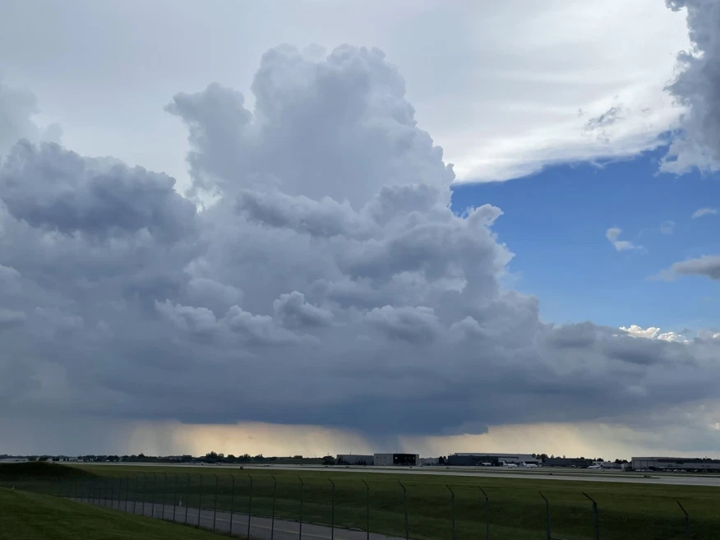
Session 2: Interactive Session
https://www.woodtv.com/weather/weather-news/with-few-thunderstorms-so-far-this-year-little-chance-severe-weather/

Slide 28
Task Overview
Goal: Compute 1-km circulation around each gridpoint in a wind retrieval of an observed supercell thunderstorm
Materials: linux_ws_exercise.tar.gz
This is a zipped tarball that contains the wind retrieval and a fortran program to compute circulation
Steps:
Copy zipped tarball to METEO Linux Network and extract contents
Load appropriate modules and create soft link for netcdf libraries
Compile fortran program
Configure input file and run fortran program
Peruse results using ncview

Slide 29






Compiled vs. Interpreted Programming Languages
Compiled | Interpreted
Source code is compiled into machine code (i.e., a binary), and the machine code is what is actually run Code must be recompiled each time it’s altered Machine code is platform dependent (i.e., it only works on the computer it’s compiled on) Pros: Tends to be faster than interpreted code Examples: C, C++, Fortran, Go | Source code is run by an interpreter, which runs the program line-by-line Code can be run on any computer that has an interpreter installed Pros: Generally easier to debug, more flexibility when changing computers, code is usually more readable Examples: Python, Matlab, Java, R, C shell
Notes:
If you’re interested, the top 50 programming languages can be found here
Additional information: https://www.freecodecamp.org/news/compiled-versus-interpreted-languages/

Slide 30
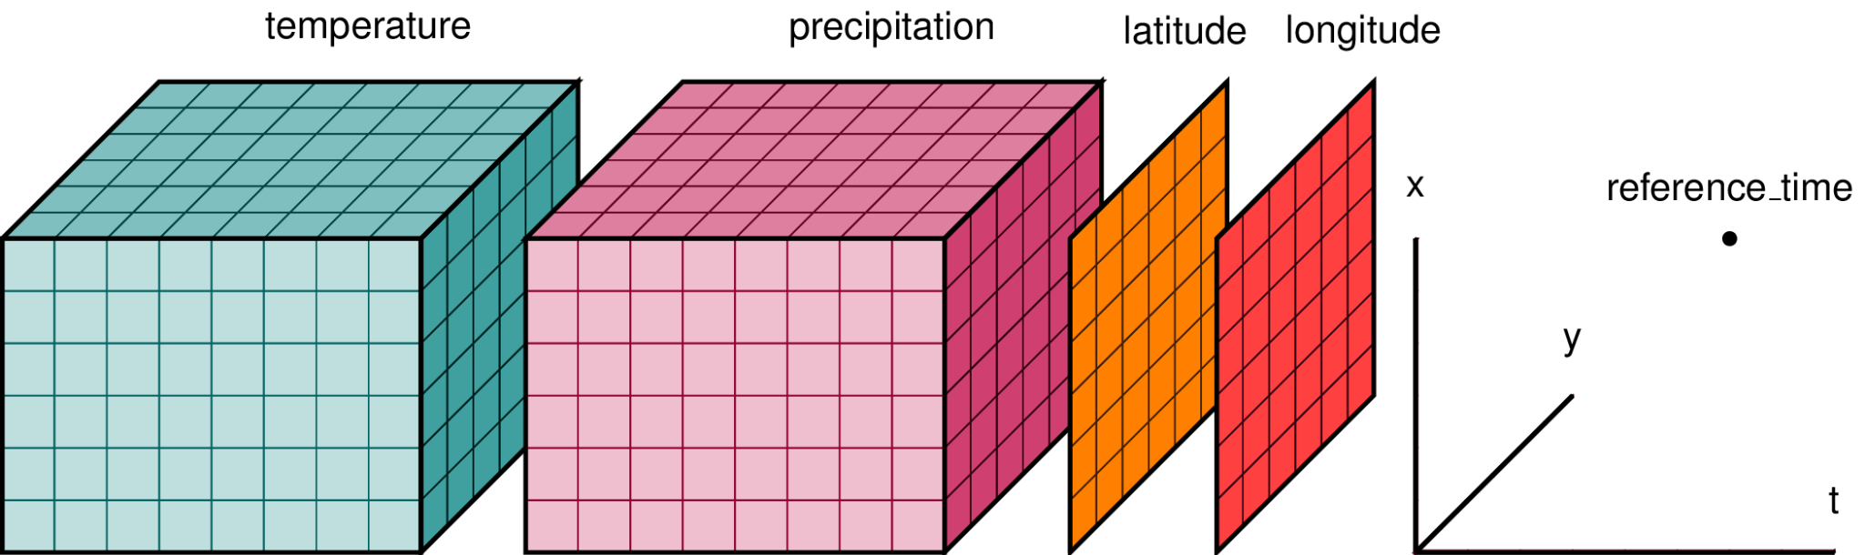
What is NetCDF?
Data format and supporting libraries developed by Unidata (part of UCAR)
NetCDF = Network Common Data Format
One of the most common data formats in meteorology
Designed to handle multi-dimensional datasets and metadata
Metadata = Variable names, units, scaling, data source (model or instrument), experiment, etc.
https://geohackweek.github.io/nDarrays/02-xarray-architecture/
https://xarray.dev/xarray-datastructure.png
Notes:
Note that the xarray python library is based on the netCDF data format
Note that users should pay attention to the ordering of dimensions when using netcdf files!

Slide 31
Copy Zipped Tarball and Extract Contents
(Inside ~ on Linux servers) mkdir linux_ws
(In Windows) Save linux_ws_exercise.tar.gz file in Downloads folder
If you don’t have it: https://github.com/DWesl/linux_ws_exercise/archive/refs/tags/v1.1.tar.gz
Open another MobaXterm tab, but don’t sign in
Navigate to the folder on your Windows machine where you saved linux_ws_exercise.tar.gz
On the Walker Desktops, this is likely C:/Users/abc1234/OneDrive\ -\ The\ Pennsylvania\ State\ University/Downloads
Note how \ is used as an escape character!
scp linux_ws_exercise.tar.gz abc1234@ulteosrv2.met.psu.edu:/home/meteo/abc1234/linux_ws/
(Switch to Linux) tar xvzf linux_ws_exercise.tar.gz
tar options used here: x = extract, v = verbose, z = unzip .gz file, and f = file name

Slide 32
Load Modules and Create Soft Link for NetCDF Libraries
cd ~/linux_ws
module list (shows loaded modules)
module avail (shows available modules)
module load pgi
module load netcdf-fortran
module load ncview
module list (should show newly loaded modules)
ln -s /usr/global-7/sw/pgi/20.7/netcdf-fortran-4.5.3 netcdf (create shortcut to netCDF libraries)
Do this in the same directory containing computeCirc_v1.1 and 7jun09

Slide 33
Inspect Wind Retrieval
Navigate into linux_ws/7jun09
ncdump -h 012232.dow6dow7.dd.nc (displays metadata)
ncdump -h 012232.dow6dow7.dd.nc | less (scroll with arrow keys; “q” to quit)
ncview 012232.dow6dow7.dd.nc (allows user to crudely visualize netcdf contents)
You can simply close this window when you’re done looking at the wind retrieval

Slide 34
Compile Fortran Program
computeCirc_v1.1 contents:
bin = Folder containing compiled binaries (we need to make these; mkdir bin if it doesn’t exist)
HISTORY = Text file that documents changes over previous versions
include = Folder containing other files needed for the program (e.g., constants)
input = Folder containing input file(s) for the program
make_computeC = Script that actually compiles the program
README = Text file containing an overview of the program
README.compile = Text file containing information about compilation
src = Folder containing the fortran code for the program
Compilation:
Navigate into linux_ws/computeCirc_v1.1
./make_computeC

Slide 35
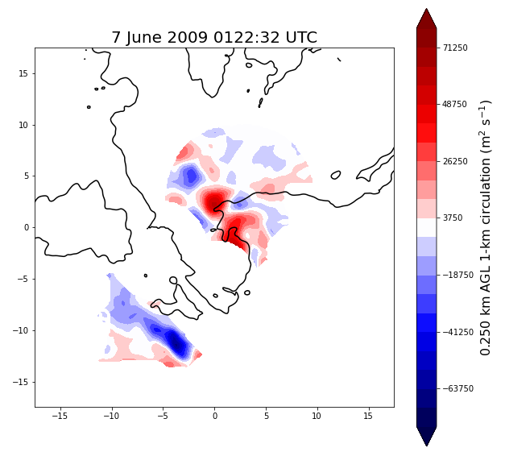
Run the Program!
Edit linux_ws/computeCirc_v1.1/input/computeC.input using nano
Make sure the infile is correct!
Within linux_ws/computeCirc_v1.1, run bin/computeC < input/computeC.input
Navigate back to linux_ws/7jun09
Examine new output using ncdump -h and ncview
Circulation at 250 m AGL (plotted using Python)

Slide 36
Bonus Activity
Repeat the the steps followed in session 2 using a script
A script is a text file containing a series of Linux commands that can be run in a single line of code
computeCirc_v1.1/make_computeC is an example of a script
For this activity, assume you have already untarred linux_ws_exercise.tar.gz and that the input file has already been modified accordingly
For an additional challenge, find a way to modify the input file within the script

Slide 37
Parting Thoughts and Bonus Slides

Slide 38
A Note About Remote Access
Not all servers in the PSU METEO Linux Network are “outward facing”
If you are not on PSU WiFi, you can only log onto lethe or anvil without the VPN
Use the GlobalProtect VPN to be able to access any server! Insrutctions can be found here.
From lethe or anvil, you can access other servers via the command ssh server
Don’t need to include your userid or .met.psu.edu
Mac users: Connect via your regular CLI
Windows users:
Option 1: Use Windows 10 CLI
Don’t need to install anything, but Windows CLI commands differ from Linux
Setting up X11 forwarding can be tricky
Option 2: Use Windows 10 Subsystem for Linux
Requires some initial setup, and X11 forwarding is still tricky
Option 3: Use third-party terminal emulator (e.g., MobaXterm, PuTTY, Git Bash, Cygwin, etc.)
Probably the easiest approach

Slide 39
Vocabulary Review (defaults on METEO system)
Kernel: Central part of Linux OS that handles interactions between the software and hardware
Distribution: Linux version or Linux flavor (CentOS)
Terminal Emulator: Graphical User Interface (GUI) that controls the appearance of the terminal window (MobaXterm (Windows))
Shell: Controls Command Line Interface (CLI) functionality (tcsh)
Server: Computer that handles requests (ulteosrv2)
Cluster: Collection of computers/servers
Node: Single device in a larger system
CPU: Central Processing Unit, typically used in reference to the number of processes that can be done at the same time

Slide 40
Useful Commands
ssh server | Connect to a server using secure shell protocol
ls [directory] | List contents of a directory
cd directory | Move to a directory
pwd | Print present directory
cp fileA fileB | Copy fileA to fileB (this will overwrite fileB)
mv fileA fileB | Move fileA to fileB (this will overwrite fileB)
mkdir directory | Make a directory
rmdir directory | Remove an empty directory
rm file | Remove a file
touch file | Create a file or update time stamp to current time
nano file | Edit a text file
file file | Print the filetype of a file
man command | Print the documentation (manual) for a command (q to exit)
module load package | Load a new package
ln -s path shortcut | Creates a shortcut to the desired path
alias name “command” | Create an alias for a command
exit | Log out of current shell; if you haven’t started another shell since logging in, or have exited all such shells, will log you out of your linux session
Note: ___ denotes required arguments, [ ] denotes optional arguments

Slide 41
Other Resources
Joe Collins’ Bash crash course (first 45 min): https://www.youtube.com/watch?v=oxuRxtrO2Ag
tcsh crash course from UMD: https://www.astro.umd.edu/~ricotti/NEWWEB/teaching/ASTR415/old_lectures/unix.pdf
Linux command cheat sheet: https://files.fosswire.com/2007/08/fwunixref.pdf
Roar training videos: https://www.icds.psu.edu/computing-services/roar-training-series/

Slide 42
The Truth About CPUs, Cores, and Processes
Hyperthreading: A method where a single core can handle multiple processes. Each process is called a thread
Threads are sometimes called “virtual cores”
The CPU core will switch between virtual cores when the currently-executing thread is waiting on data from memory, disk, or the network
Socket: Place on a motherboard to plug in a computer chip
Often, # sockets = # computer chips
Determining the number of processors:
Processors = (# computer chips or sockets) X (# cores per chip) X (# threads per core)
Processors are also called CPUs
lscpu displays the number of sockets, cores, threads, and CPUs

Slide 43
Example: ulteosrv2
ulteosrv2
Socket 1: Intel Xeon E5-2420
Socket 2: Intel Xeon E5-2420
C
C
C
C
C
C
C
C
C
C
C
C
T
T
T
T
T
T
T
T
T
T
T
T
T
T
T
T
T
T
T
T
T
T
T
T
Each chip has 6 cores (denoted C), and each core has 2 threads (denoted T). Because ulteosrv2 has 2 computer chips, this means ulteosrv2 can handle 2 X 6 X 2 = 24 processes (aka 24 CPUs)

